Slide 1
OSDU Well Delivery DMS Contribution
Apr. 2021

Slide 2


Agenda
Well Delivery DMS contribution scope
High level architecture
Generic entity based API
Domain workflow based API
Code structure and documentation
Well Delivery: Data Management Services focused on Well Planning and Well Execution
Notes:
Well Delivery DDMS Contribution Scope.
- Here I’ll talk about what we have contributed so far.
- What we will be contributing in 2021
- Well Delivery Data Management Services
is focused on well planning and well execution
High level architecture.
What isolation layer is in place.
Relationship between well delivery DDMS & OSDU Core Services and API
Then will go through API we contributed
- There are 2 category of API’s
- one is generic entity based data access API’s
- very similar to what core team has a pattern
- you access resources based on Type and ID
- and the second one is domain based
- more sophisticated API
- based on few use cases we proposed.
- As the domain workflow grows
- this part of the API’s will grow significantly
Code Structure and Documentation associated with it

Slide 3
SLB OSDU Well Delivery DMS Team
Project Manager: Diana Galindo
Developer: Sheng Wang
Data Modeler: Stuart Donaldson
QA Engineer: Mary Spanjers
Architects: Yao Jia, Arun Shanmugam
Notes:
I would like to introduce, Schlumberger OSDU team
- Diana is our Project Manager
- Sheng is our Key Developer
- He has contributed all the code, you’ll see in GITLAB
- Stuart works closely with the Data Definition team
- He is our Data Modeler and Data Architect
- Mary is our QA Engineer, Qualifying the code
- Yao Jia is an well construction Architect contributing
as an Architect until Season 1 delivery
- and I will be contributing as an architecture from
Season 2 onwards

Slide 4
Well Delivery DMS objectives
Establish workflows and common domain models for Well Delivery domain
Well Planning - Contributed 2020
Well Execution - To be contributed 2021
Provide domain aware storage service
Provide standard data access APIs
Provide domain workflow APIs
DMS: Data Management Services
Notes:
Objectives of this contribution
By doing a WD DDMS, we can establish a common domain model
- Including
- Construction process of well
- Planning of the well and
- Completion as well
We will take a step by step approach of working and contributing different domains
- 2020, we have contributed well planning.
- Which is going through some revisions
- 2021 we will be contributing well execution
Implemented domain aware storage - JSON document data store.
- On the top of that we will provide
- Domain based API’s
- Data access (entity) based API’s.
- Those are standard API’s, implemented in Java
Those are the objective of our contribution

Slide 5
What did we contribute in 2020?
Well delivery planning domain model definition
Schemas and data object examples
Well delivery DDMS implementation
JSON object store
Azure Cosmos DB with MongoDB API based implementation
Strongly typed data access APIs
Use case driven domain workflow APIs
API documentation and samples
Notes:
2020, we delivered Well Planning domain
To be more specific
- Since planning model is more complex
- and has a lengthy review process
- we did not want to build everything after it is finalized
- we took an approach that we build and adjust our
implementation.
On the implementation side
- we have implemented a JSON document object store
- that is based on mongo db api.
- This makes the solution portable
- On the Azure cloud, we have cosmos DB as a backend
- Accessing through Mongo DB API drivers
- So in case, if it has to be implemented in any other CSP
provided data store we donot have to change the code
at the API level
The data access API we provide are considered strongly
typed. because it is aware of the data type definition
and model and it does the validation.
Use case driven domain workflows APIs
For e.g. well planning api’s based on Offset Well Analy..
consuming the planning data in execution system
All the documentation will have documentation and
Sample Payload

Slide 6
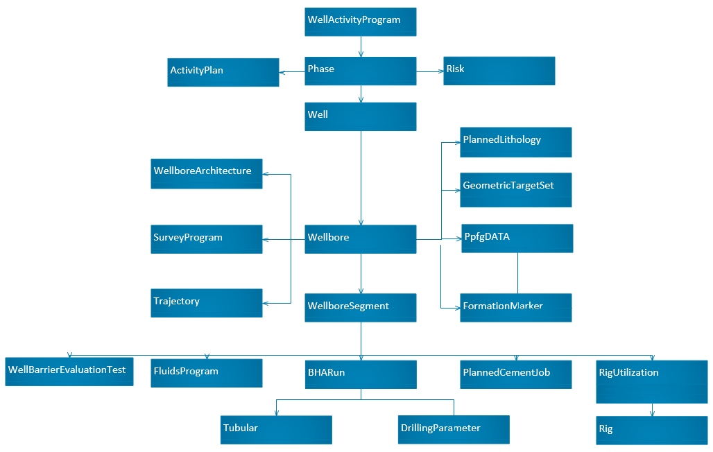
Well Delivery domain object hierarchy contributed to OSDU

Slide 7
High level architecture
Well Delivery DDMS
OSDU Core
Entitlement
Service
Web API
Generic Entity based API
Domain Workflow based API
Compliance
Service
Service Interfaces
Schema
Service
Service Implementation
Domain Data Access Service
Generic Entity Storage Service
Storage
Service
Storage Client
OSDU Core Index
DDMS Store with
MongoDB API
OSDU Core Storage
Registration
Service
Notes:
High Level Architecture
- As part of OSDU and live in the OSDU space
- WD DMS has made into the dependency and
relationship to OSDU core API
- WD DMS is a typical server side multi layer architecture
- Where we provide
- On the top http rest API layer, that handles
http aspect of the service
- then underneath, we have services implementation
each targeting API uses cases
- Service layer itself is an abstract using service interfaces
- we can use the master service as replacement in our
automated test as well
- Service layer basically encapsulates the business
logic of the well delivery data domain
- As I highlighted before, there are 2 category of service API
- one is more domain focused
- the other more generic data based storage service
- This one talks to more OSDU core Service APIs
so it can participate with any workflow from
OSDU core API
Moving down a layer
- We have abstraction built into
- allow us to target a storage client fassad
- today we have 2 layer fassad
- one is basic storage client
- we can implement your own tech.
as long as you satisfy the storage client api
but in that case, you might have to change
the query functionality
- Other one is Mongo db fassad
- which we use as a standard mongo DB interface
- we can implement mongo DB compatible flavors
- such as cosmos DB war from Azure
As for the dependency on the OSDU Core API
- Dependency on the OSDU Core what we do today
- Index search API
- We persist the data in 2 formats
- we store data in the JSON object store
- we push those data into OSDU core cloud storage
We tend to rely on the core services to validate
- Schema, Entitlement and storage services

Slide 8




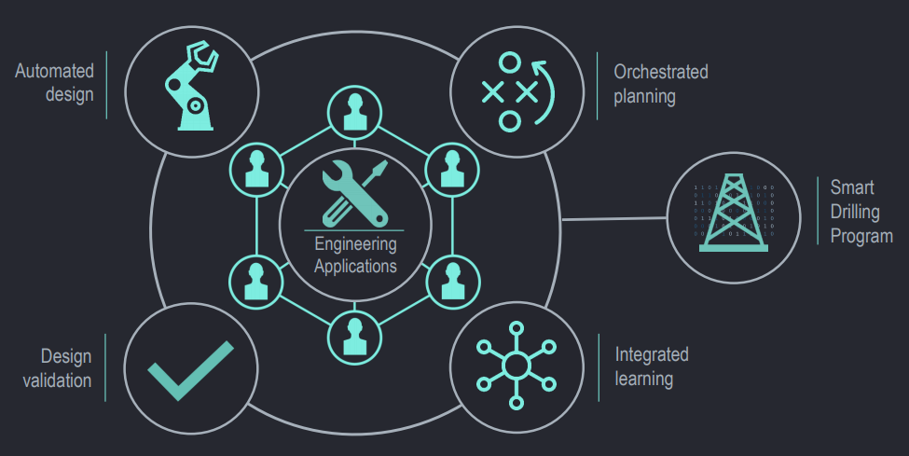





Example of Well Activity Program delivered to CVX OSDU store
Data Foundation
Seismic
wellbore
Well Delivery OSDU Services
Well Delivery OSDU Services
OSDU Core
Service Azure Resource Group
Well Activity Program
Well Activity Program
OSDU Pipeline
WCDF
Permanent Storage
Wellbore DMS
RE DMS
OSDU Well Delivery Domain API
Seismic DMS
SLB Azure Subscription
Well Delivery DMS
Petrel DMS
Data objects included in the Well Activity Program:
Well, Wellbore, Wellbore Geometry, Trajectory, Survey Program, Wellhead and BOP, Section, BHA Run, BHA, Drilling Parameter, Risk, Activity Plan, Mud Design, Pore/Frac Pressure, Evaluation, Cement Design, Formation Marker, Rig
Data Azure Resource Group
External Cloud Subscription
Notes:
Example of a “Well Activity Program” being delivered from
DrillPlan to the Well Delivery DMS (OSDU storage).
In the CVX example the “Data Foundation” is in their
external subscription.

Slide 9
Domain workflow based API
Based on the knowledge of domain model
Complex query and object hierarchy traversal
Multiple entity type APIs
Designed for consumption
Focus on read access to the data
Enable complex query and object hierarchy traversal
Domain use case driven
Notes:
We can see multiple entity type
It is designed for consumption
We have relationship builder which can
Put all relate object together and give us a
Wholistic view.

Slide 10
Domain use cases
# | Use Case | Input to API | Data Fetched
1 | In data exchange applications, I need to get approved Well Activity Program for a well, so that it can be stored in client system of references | Given a Well Id | Get the latest version of Well Activity Program
 |  | Given a Well Id & Well Activity Program Version | Get a specific version of Well Activity Program
2 | In downstream execution applications, I need to retrieve a set of planned objects from a well plan for the target well, so that I can initialize execution system with the plan. | Given a Well Id | Get the Activity Plan of a Well
3 | In data analytics applications, I need to get a list of specific planned objects (e.g. trajectory, BHA Run etc.) for a list of wells, so that I can perform offset well analysis with these set of wells | Given a Well Id | Get the BHARun list
 |  |  | Get the trajectory list
4 | In drilling interpretation applications, I need to get a list of planned objects that is in the given operation activity context (e.g. runs or wellbore segments), so that I can use these objects to run drilling engineering computations. | Given a Wellbore Id | Get wellbore segments for a wellbore
 |  | Given a Wellbore Segment Id | Get BHA runs for a wellbore segment
5 | As an application developer, I need to retrieve a summary of the well plan with a lists of URI references to the objects belongs to the plan, so that I can pick what objects I need and fetch them concurrently. | Given a Well Id | Get the latest version of a Well Activity Program tree
 |  | Given a Well Id & Well Activity Program Version | Get a specific version of a Well Activity Program tree

Slide 11
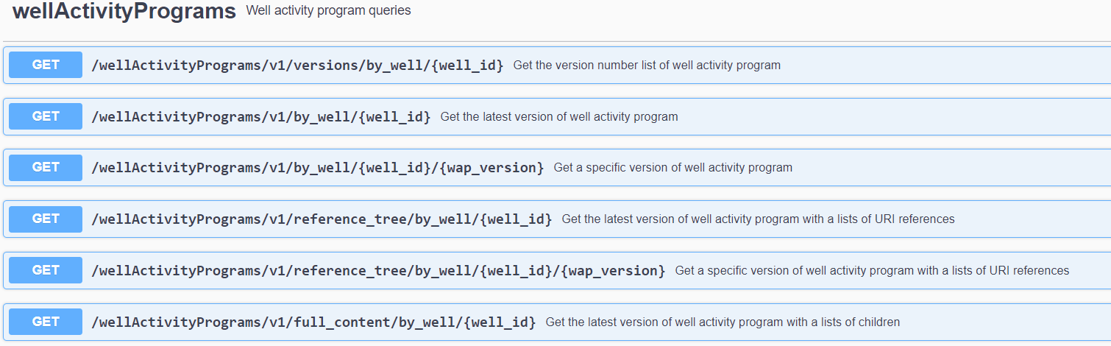
Domain API - Well Activity Program
Notes:
Get

Slide 12
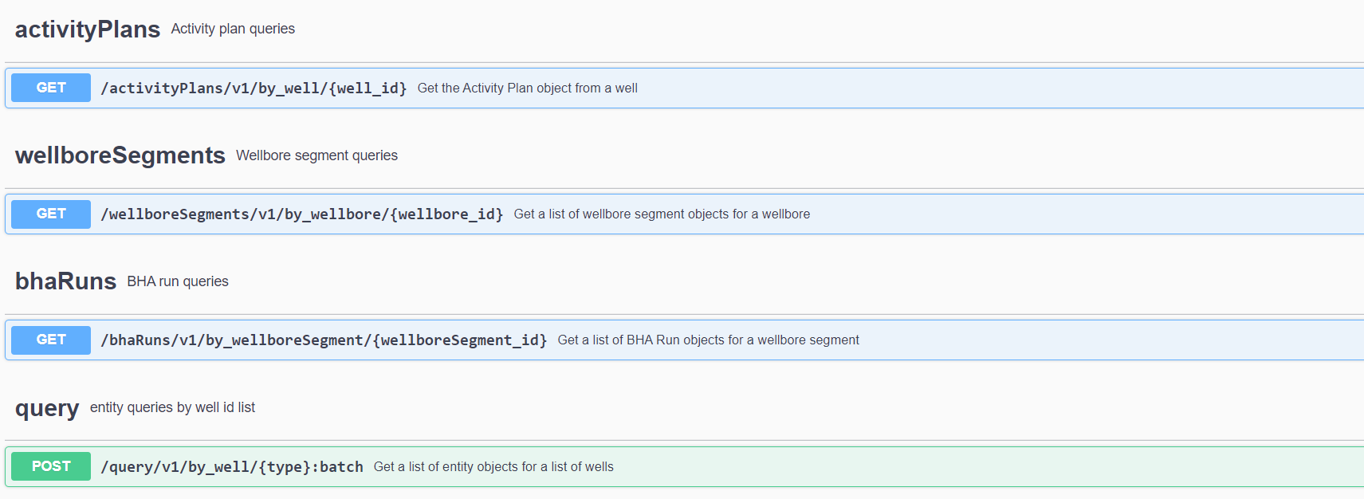
Domain APIs - Others
Notes:
Activity Plan - Get Activity plan object from a Well
Sections - Get list of section objects for a WellBore
bhaRuns - Get list of bha Runs for a Section
Query - Get a list of entity objects for a list of Wells

Slide 13
Generic entity based API
Follows entity based pattern
/storage/v1/{type collection}/{id}/{version}
Store data in JSON document store
Azure CosmosDB using MongoDB API
Store data payload as JSON file in OSDU core file store
To enable all workflows based OSDU core store. Such as Index Search etc.,
Establish entity relationships based on model hierarchy
Saved as part of entity document today, can be externalized in the future
Implement domain model validation logic
Soft validation - validation flag in the document
Notes:
We can look at entity based API
- We follow the similar pattern what is done in the
OSDU core
- Every update will result as a new view
- We have Azure based implementation
- Cosmos DB data store with MongoDB API
- Store data payload as JSON file in OSDU core file store
Enable all workflows based OSDU core store - e.g. index and search, map visualization etc.
- Today entity relationship are captured document
This can be externalized later with some graphic data bases
- Implement domain based validation logic

Slide 14
Generic entity based API
# | Feature | Details
1 | Follows Entity based pattern | /storage/v1/{type collection}/{id}/{version}
2 | Stores data in JSON document store | Azure Cosmos DB using Mongo DB API
3 | Stores data payload as JSON file in OSDU core file store | To enable all workflows in OSDU Core store. Such as Index Search etc.,
4 | Establish entity relationship based on model hierarchy | Saved as part of the entity document today. This can be externalized later by using graph DB
5 | Implement Domain model validation logic | Soft validation – Store validation flag in the document
Notes:
We can look at entity based API
- We follow the similar pattern what is done in the
OSDU core
- Every update will result as a new view
- We have Azure based implementation
- Cosmos DB data store with MongoDB API
- Store data payload as JSON file in OSDU core file store
Enable all workflows based OSDU core store - e.g. index and search, map visualization etc.
- Today entity relationship are captured document
This can be externalized later with some graphic data bases
- Implement domain based validation logic

Slide 15
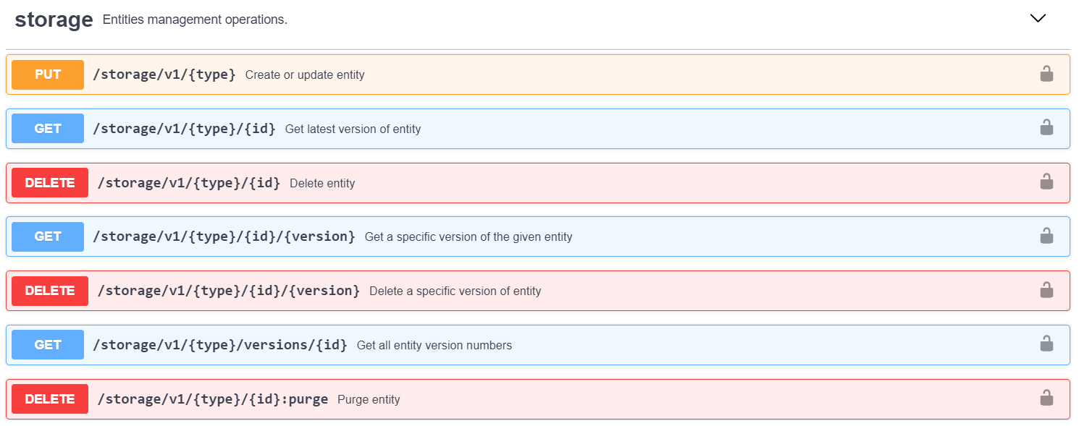
Generic entity based API
Notes:
Storage API quick view
- Create or update entity
Get latest version of the entity
Delete Entity (This is a soft delete)
Get specific version of given entity
Delete specific version of given entity
Get all entity version numbers
Permenantly delete id object

Slide 16
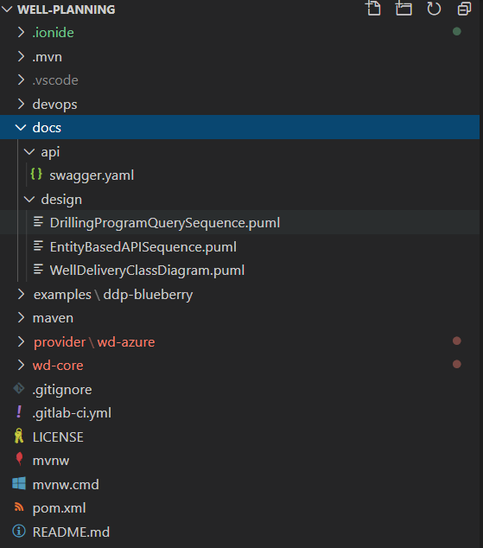
Code structure and documentation Link
API Doc
Design Diagrams
Entity JSON Doc Examples
Code

Slide 17
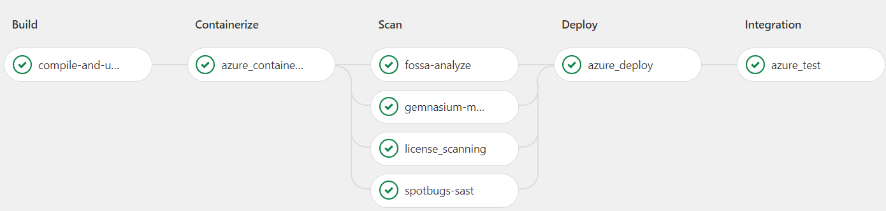
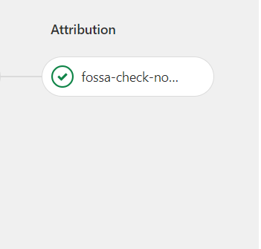
Well Delivery – GITLAB CI/CD Pipeline Link
Notes:
CI/CD Pipeline of
Build, Containerize, Scan, Deploy, Integration, Attributions are performed

Slide 18
Few data object examples
# | Data Objects | Definition | Document
1 | Activity Plan | Engineering activities planned during Well Planning | Link
2 | BHARun | Bottom Hole Assembly Run details | Link
3 | Well Activity Program | Well planning and execution part of the well | Link
4 | Rig | An integrated system that drills wells | Link
5 | Risk | Risk factors involved while drilling a well | Link
Notes:
Activity Plan - Get Activity plan object from a Well
Sections - Get list of section objects for a WellBore
BHARuns - Get list of bha Runs for a Section
Query - Get a list of entity objects for a list of Wells

Slide 19
Q & A
Notes:
Activity Plan - Get Activity plan object from a Well
Sections - Get list of section objects for a WellBore
BHARuns - Get list of bha Runs for a Section
Query - Get a list of entity objects for a list of Wells

Slide 20
What we will be contributing in 2021?
Well execution domain model definition
Schemas and data object examples
Drilling Report
Fluid Report
BHARun

Slide 21
References links
Well planning code repo
https://community.opengroup.org/osdu/platform/domain-data-mgmt-services/well-delivery/well-delivery
OSDU Core service client repo
https://community.opengroup.org/osdu/platform/domain-data-mgmt-services/well-delivery/well-delivery-lib/-/tree/ado-code-push
Data definition repo
https://gitlab.opengroup.org/osdu/subcommittees/data-def/work-products/schema/-/tree/WellPlanning
SLB contribution presentation recording link
https://opengroup.webex.com/recordingservice/sites/opengroup/recording/play/1296a3d1064a44398aa9c6f9183385a5

